Slide 1
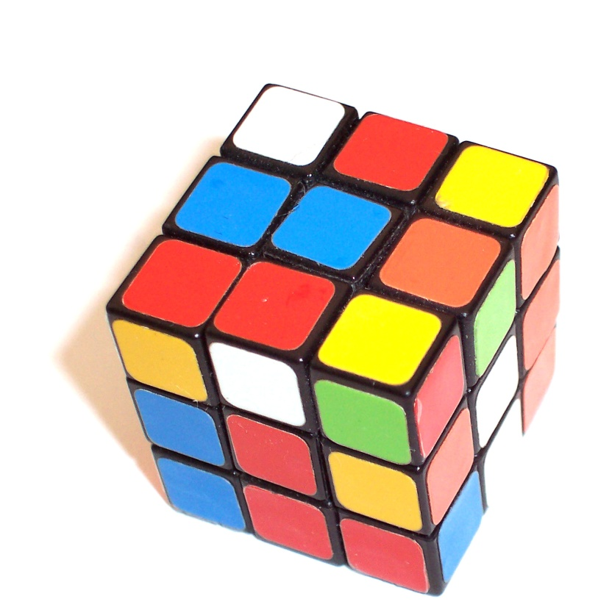
Information Literacy
through Inquiry
Using problem-based learning in information literacy instruction
Alan Carbery,
Waterford Institute of Technology

Slide 2

Students usually approach their research without regard to the library’s structure or the way that library segments different resources into different areas of its web site. (CIBER, 2008)
Students lack ability to evaluate information

Slide 3

IAKT syndrome occurs when higher level students assume they have little to gain from IL instruction.
‘One way to deal with IAKT syndrome is to challenge the students to demonstrate their expertise’ (Bell, 2007, p. 100).

Slide 4

“There is increasing evidence that supports the belief that active, experimental education experiences are more transferable than passive, lecture-based instruction” (Hsieh & Knight, 2008)

Slide 5
IL instruction is the key to the success of PBL. Students need to develop their information need in order to work on the problem presented (Breen & Fallon, 2005).
Students involved in PBL require more IL skills than those studying in more traditional learning environments (Dodd, 2007)

Slide 6

Classes taught using the modified PBL approach tended to generate far more student participation and engagement than traditional lectures (Munro, 2006).

Slide 7

The most rewarding feature of engaging in a PBL session is having the opportunity to interact with students in a more dynamic environment (Kenney, 2008)

Slide 8

Can problem-based learning be used in one-shot, 60 minute information literacy instruction sessions to create an active, student-centred learning experience?

Slide 9
Plan
Act
Observe
Reflect

Slide 10

Students work in groups of three and assign themselves into the role of seeker, scribe and spokesperson.
A research trigger drives the entire workshop session, with students asked to find library research materials based on the trigger.
The workshop is delivered in three phases: Brainstorming Phase, the Search Phase and the Presentation Phase.

Slide 11
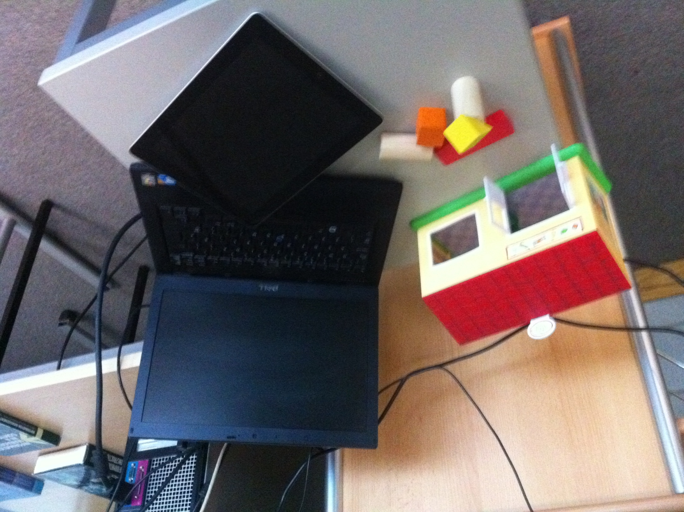

Slide 12
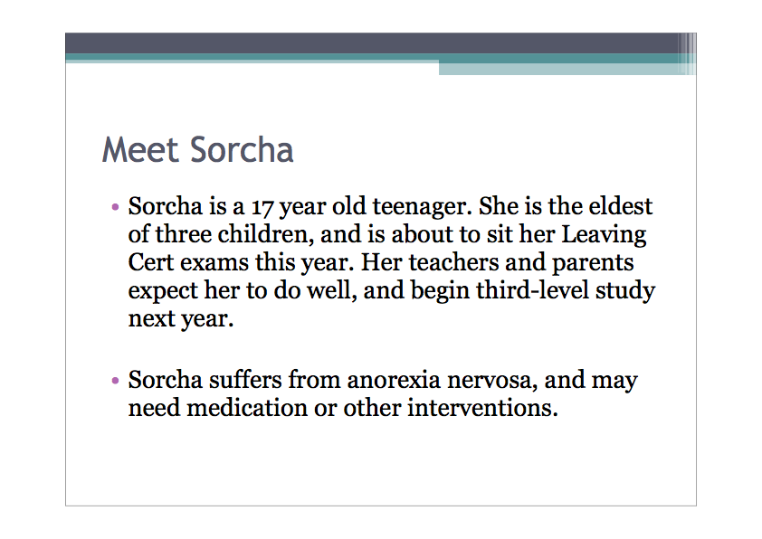

Slide 13

98.5% rated the workshop session as excellent, or very good.
94% enjoyed getting involved in the group-based workshop activities.

Slide 14

“It was helpful to begin with a brainstorming phase rather than going straight to the databases. It helped to have a clearer idea of what exactly we wanted to search before we started”
“Wouldn’t have done it before now, but I will try to brainstorm from now on”

Slide 15

I clearly noticed a shift in most of the students’ thought processes from hazy, abstract and uncertainty, towards some clearer idea of the topic at hand.

Slide 16

“The large amount of information was overwhelming at times, but we soon worked at refining our search”
“There were often difficulties with the amount of results found, but we were instructed appropriately how to narrow this down”

Slide 17

Using classroom time on active learning group exercises allows the teacher to become a facilitator for learning and to provide directed attention to students and groups on an as-needed basis (Mitchell & Hiatt, 2010).

Slide 18
I can’t try and predict the problems students will face; they must face the search difficulties and I’ll be there to guide them to overcoming these issues.

Slide 19
Initiation
Selection
Exploration
Formulation
Collection
Presentation
Uncertainty
Confusion, frustration
Clarity
Optimism
Confidence
Relief
Zones of Intervention
Kuhlthau’s Information Search Process Model, 2004

Slide 20

Guided inquiry is planned, targeted, supervised intervention throughout the inquiry process... Guided inquiry provides essential intervention at critical points in the inquiry process that fosters deep personal learning’ (Kuhlthau, 2010, pp. 4).

Slide 21

“It was audible and visible when they started to achieve results. You could almost see a lifting in the room” (Peer Observer 2).
“There were breakthrough moments” (Peer Observer 1).

Slide 22

Transformative Learning is about discovering the context of ideas and the belief systems that shape the way we think about their sources, nature, and consequences, and on imagining alternative perspectives (Mezirow, 1997).

Slide 23
“It’s good to see how other people searched and what was the best way to research the area”
“I think that until students hear that their peers had the same problems or issues, rather than us librarians saying it, that there’s a real difference there. The presentation phase can be really, really useful.” (Peer Observer 1)

Slide 24
I find the Presentation phase really useful to revisit important IL concepts. Students themselves actually report on the importance of keyword choice in their searches.
The presentation phase feels like a reflective stage.

Slide 25

Curve Balls

Slide 26

“I think one class a week should be given over to this”
“Because it’s nursing, would the research advisor need to have, or have someone with him with, nursing knowledge?”

Slide 27

The most challenging aspect of incorporating PBL into one’s teaching repertoire is taking on the role of guide, facilitator, or tutor. As the learning activity becomes user-centred, the librarian must step aside to allow the students to take responsibility for their own learning (Kenney, 2008, p. 390).

Slide 28

“What’s needed in a PBL classroom is trust. Actually trusting the students enough to let go; to let them take the time to look at this, and to believe and trust that they’ll actually focus in on what you want them to” (Peer Observer 1)

Slide 29

“International students struggled at times” (Peer Observer 1).
“There’s a demand on instructors to be perceptive towards group dynamics, and maybe display emotional intelligence in reading the group & comfort levels of certain individuals” (Peer Observer 2).

Slide 30

Time is definitely a factor. I would say that the experience of the facilitator would be very important to keep within the parameters and being aware of the limitations (Peer Observer 2)

Slide 31

“Perhaps if the trigger itself was linked to a project, and then you were able to tie in and actually demonstrably show, based on evidence, how it actually worked in practice” Peer-observer 2.

Slide 32

Process, not product
Interventions guide personal threshold concepts, and assessment is at the point of instruction.
POGIL, not PBL?

Slide 33

We’re in a highly energised room. There is lots of chatter and discussion on-going.
I definitely think that the use of PBL has created a more dynamic, exciting, creative and interactive session for these students.

Slide 34
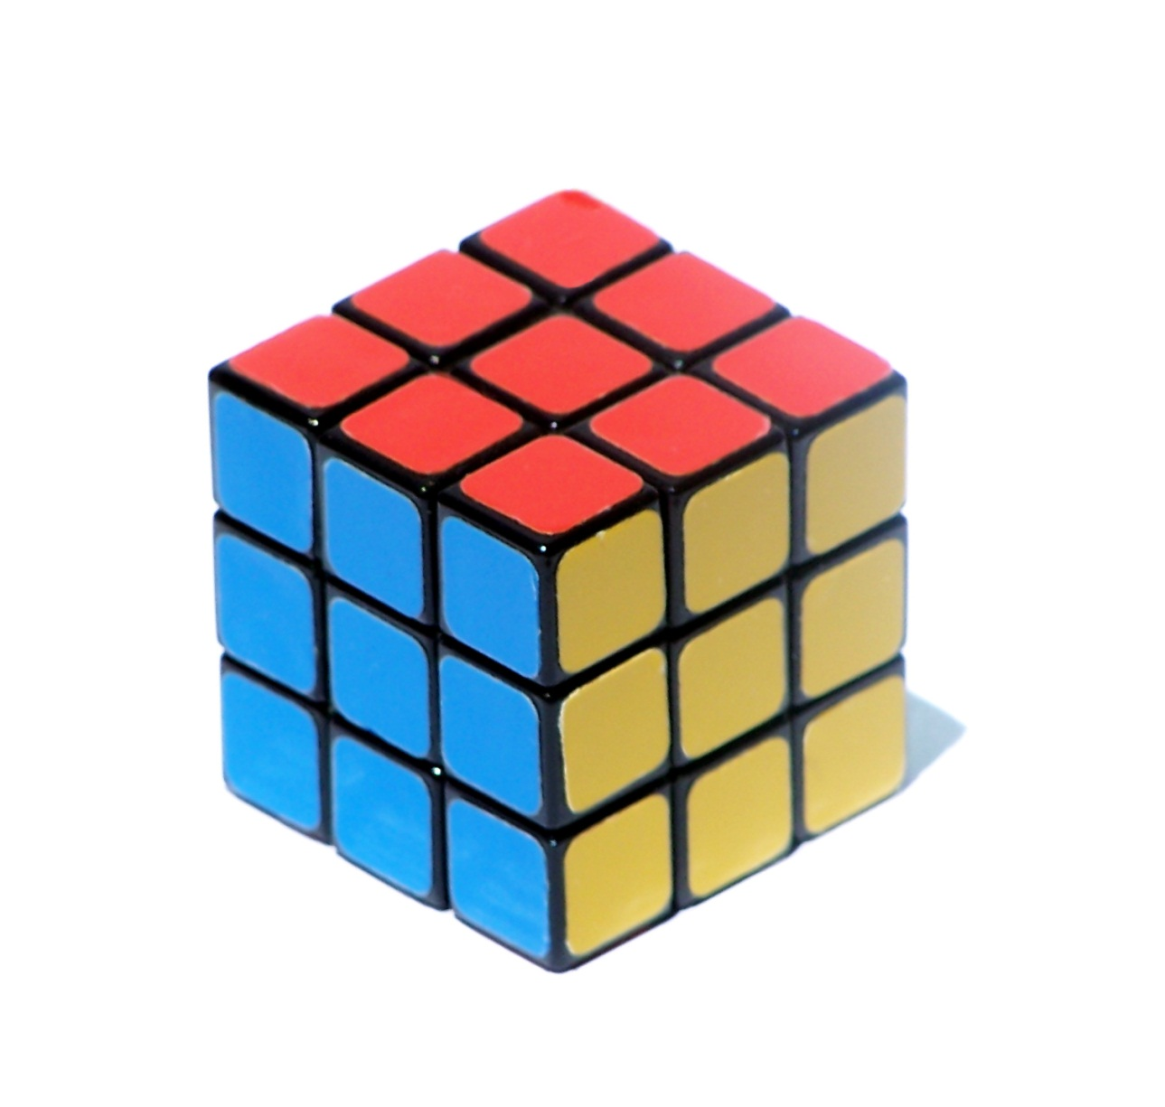
Alan Carbery
Waterford Institute of Technology
E: acarbery@wit.ie
Twitter: @acarbery
Slideshare: www.slideshare.net/acarbery

Slide 35
Bell, S. J. (2007)’Stop IAKT syndrome with student live search demos’, Reference Services Review, 35 (1), pp. 98-108.
Breen, E. and Fallon, H. (2005) ‘Developing student information literacy to support project and problem-based learning’, in Barrett, T. and MacLabhrainn, I., (eds) Handbook of enquiry and problem-based learning: Irish case studies and international perspectives. Galway: Centre for Excellence in Teaching and Learning, NUI Galway and AISHE, pp. 179-188.
CIBER (2008) Information behaviour of the researcher of the future, UCL, London. Available at: http://www.ucl.ac.uk/infostudies/research/ciber/downloads/ggexecutive.pdf (Accessed 2 April 2012).
Dodd, L. (2007) 'The impact of problem-based learning on the information behavior and literacy of veterinary medicine students at University College Dublin', The Journal of Academic Librarianship, Vol. 33, No. 2, pp. 206-216.
Hsieh, C. and Knight, L. (2008) 'Problem-Based Learning for Engineering Students: An Evidence-Based Comparative Study', The Journal of Academic Librarianship, Vol. 34, No. 1, pp. 25-30.
Kenney, B. F. (2008) 'Revitalizing the One-Shot Instruction Session Using Problem-Based Learning', Reference & User Services Quarterly, Vol. 47, No. 4, pp. 386-391.
Kuhlthau, C.C. (2004) Seeking meaning: a process approach to library and information services, 2nd ed., Connecticut, Libraries Unlimited.
Kuhlthau, C.C. (2010) ‘Guided inquiry: school libraries in the 21st century’, School Libraries Worldwide, 16 (1), pp 1-12.
Mezirow, J. (1997) ‘Transformative learning: theory to practice’, New Directions for Adult and Continuing Education, (74), pp. 5-12.
Mitchell, E. and Hiatt, D. (2010) 'Using POGIL Techniques in an Information Literacy Curriculum', The Journal of Academic Librarianship, Vol. 36, No. 6, pp. 539-542.
Munro, K. (2006) ‘Modified problem-based library instruction: a simple, reusable instruction design’, College & Undergraduate Libraries, 13 (3), pp. 53-61.
Images:
All Images obtained under Creative Commons License:
Slides 1, 2, 8, 17, 21, 27, 34 available from http://www.sxc.hu using keywords rubric, graduates, question mark, direction, problem and beginning.
Slides 3, 4, 6, 7, 10,13,14,15,16,20,22, 26,29,30,31, 32 available from http://www.freedigitalphotos.net using keywords bored, student, solution, innovation, spanner, like, brainstorm, journal, search, intervention, butterfly, idea, difficult, time, mark, and process.
Slide 25 image available from Flickr http://www.flickr.com/photos/karlequin/200427012/
Slide 28 image available from Flickr http://www.flickr.com/photos/grrphoto/246147199/
Slide 33 image available from Flickr http://www.flickr.com/photos/bazik/395792175/

