Slide 1
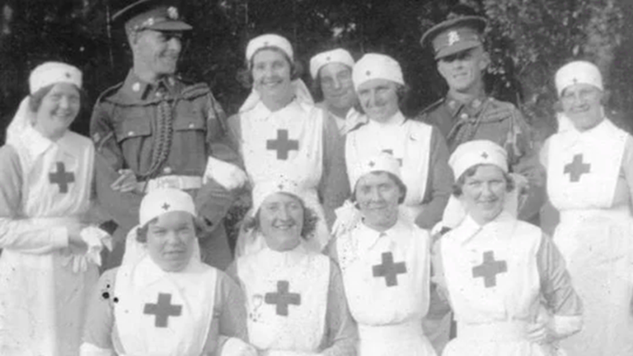
Caregiving at Irish Military Hospitals during and After the First World War, 1914-1930
Julie Crowley
South East Technological University, Waterford

Slide 2
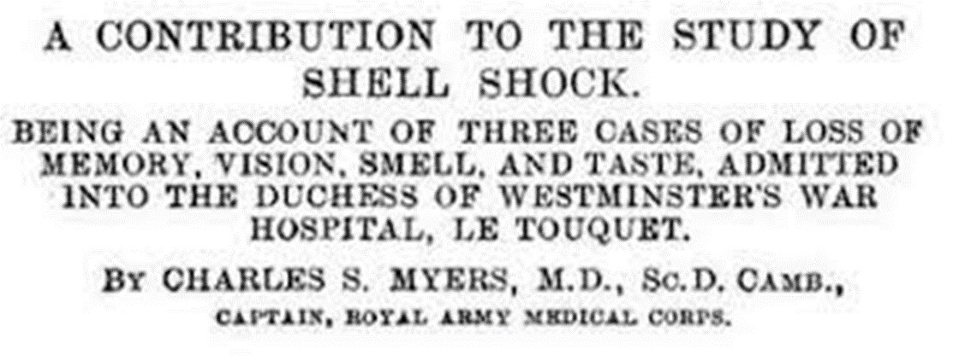
Shell Shock: Context and Background
Dr Charles S. Myers of the Royal Army Medical Corps

Slide 3
Irish Military Hospitals

Slide 4
Leopardstown Park Hospital
“…Leopardstown Park was one of just three hospitals in the Free State dedicated to the treatment of First World War veterans, even though more than 30,000 men in Ireland were in receipt of disability pensions.”
- Eoin Kinsella, Treating the Traumatised: Shell-shocked veterans in the Irish Free State.

Slide 5
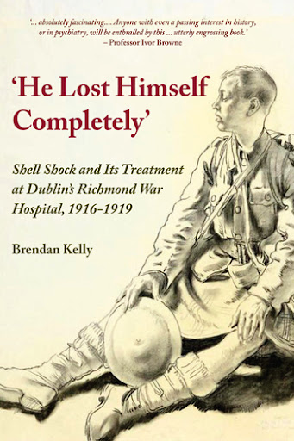
Treating Shell Shock: The Richmond War Hospital
The Richmond War Hospital, located in Grangegorman, Co. Dublin, was a 32-bed specialised institution that treated 362 veterans with ‘nervous and mental troubles’ (later recognised as shell shock) between 1916 and 1919.

Slide 6
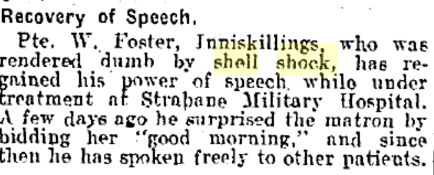
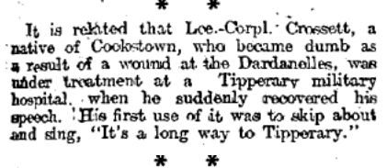
Newspaper Reports of Shell Shock Recovery
Source: Irish Independent, 28 August, 1917, page 3
Source: Irish Independent, August 01, 1916; Page: 4
Source: Belfast Newsletter, 14.June .1916, page 6
Donegal News, 04 March 1916, page 5

Slide 7
Funding Issues for War Hospitals
Source: Freeman’s Journal, 22 July 1919
Source: Irish Independent, 10 May 1919
Source: Freeman’s Journal, 20 October 1919

Slide 8
Irish Military Archives: The Army Nursing Service
Departmental A- Files
Reference Code: DOD-A-11900
File Title Presidents Office (J. McGrath, TD) - Complaints - By Mrs A. Conroy and Mrs K. C. Boland, late Army Nursing Service, regarding Demobilization
Date: 1923-1924

Slide 9
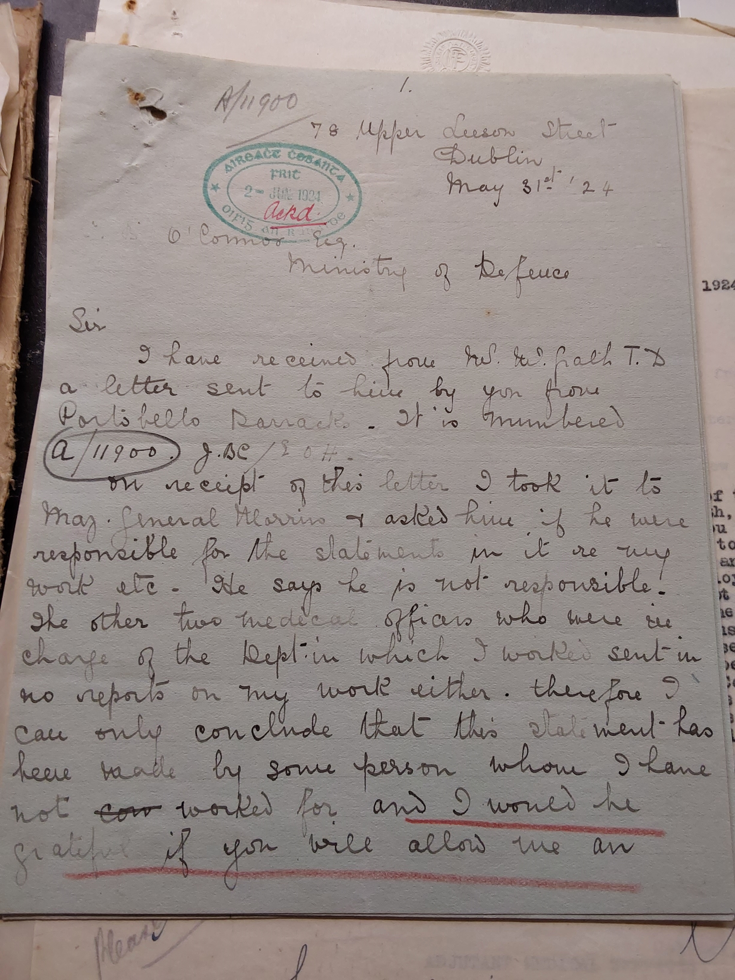
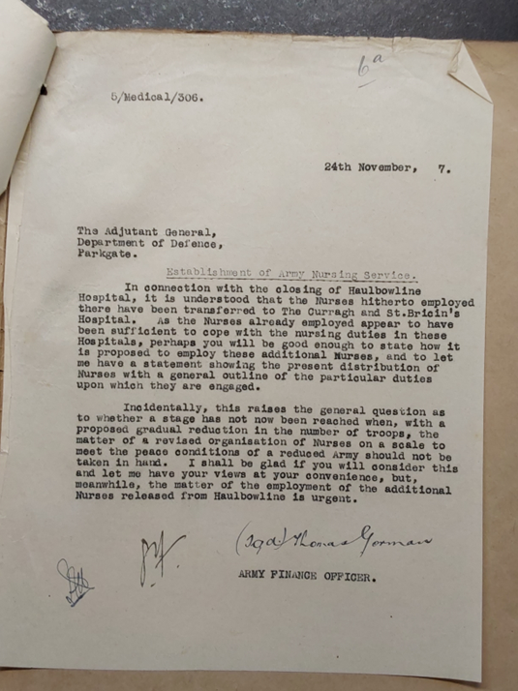
The Demobilisation of Nurses and Closure of Military Hospitals
Departmental A- Files
Reference Code: DOD-A-11900
File Title Presidents Office (J. McGrath, TD) - Complaints - By Mrs A. Conroy and Mrs K. C. Boland, late Army Nursing Service, regarding Demobilization
Date: 1923-1924
Collection Name: Departmental A- Files
Reference Code: DOD-A-07615
File Title Nurses Pay Army Navy Services
Date: 1922-1923
Collection Name: Army Finance Office
Reference Code: 5-Medical-306
File Title: Army Nursing Service, Establishment of
Date: 1927-1928

Slide 10
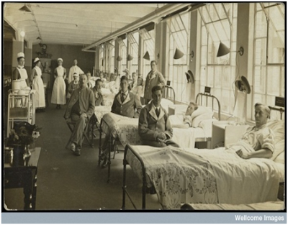
Conclusions
Impact on caregivers and veterans
Closure of some military hospitals
Reduction of the Army Nursing Services in the 1920s
The remaining military hospitals continued to treat veterans despite their budget limitations
Richmond Hospital room, Wellcome Images, L0060826, Wellcome Library
(History of Medicine in Ireland Blog by David Durnin)

Slide 11
References
Casey, P., Cullen, K. and Duignan, J. (2015) Irish Doctors in the First World War. Kildare: Merrion Press.
Durnin., D. (2019) The Irish Medical Profession and the First World War. Britain: Palgrave Macmillan.
Irish Newspaper Archive. https://archive.irishnewsarchive.com/
Kelly, B. D. (2015) 'Shell shock in Ireland: The Richmond War Hospital, Dublin (1916–19)', History of Psychiatry, 26(1), pp. 50-63. doi: 10.1177/0957154x14554378.
Kinsella, E (2023). Treating the traumatised: Shell-shocked veterans in the Irish Free State. RTE Century Ireland. https://www.rte.ie/centuryireland/index.php/articles/treating-the-traumatised-shell-shocked-veterans-in-the-irish-free-state
Leopardstown Park Hospital: History. http://www.lph.ie/history.php
Myers, C. S. (February 1915) 'A Contribution to the Study of Shell Shock: Being an Account of Three Cases of Loss of Memory, Vision, Smell, and Taste, Admitted into the Duchess of Westminster's War Hospital, Le Touquet', The Lancet, pp. 316-320. doi: https://doi.org/10.1016/S0140-6736(00)52916-X.
Orr, P. (2017) 'Craigavon House: Caring for Veterans Through the Decades', https://www.militaryheritage.ie/wp-content/uploads/2018/03/MHIT-Publication-Craigavon-House-Caring-for-Veterans-Throughout-the-Decades-by-Philip-Orr.pdf
Red Cross (2023). ‘Volunteering During the First World War.’ https://vad.redcross.org.uk/volunteering-during-the-first-world-war
Robinson, B. M. (2020) Shell-shocked British Army Veterans in Ireland, 1918-39: A Difficult Homecoming. Disability History, Manchester: Manchester University Press.
Taylor, P. (2012) Heroes or Traitors? Experiences of Returning Irish Soldiers from World War One. Oxford: University of Oxford.

