Slide 2
Engaging With Digital Twin And Landscape Biography: Protecting An Ecosystem
Dr. Emily Shakespeare & Dr. Robin Stubbs
Ireland
SABRE Research Centre, Department of Architecture & Built Environment, South East Technological University
Notes:
3 year transdisciplinary project funded by the Irish EPA. Combining dt and lb to protect a vulnerable coastal ecosystem in the south east of Ireland.

Slide 3
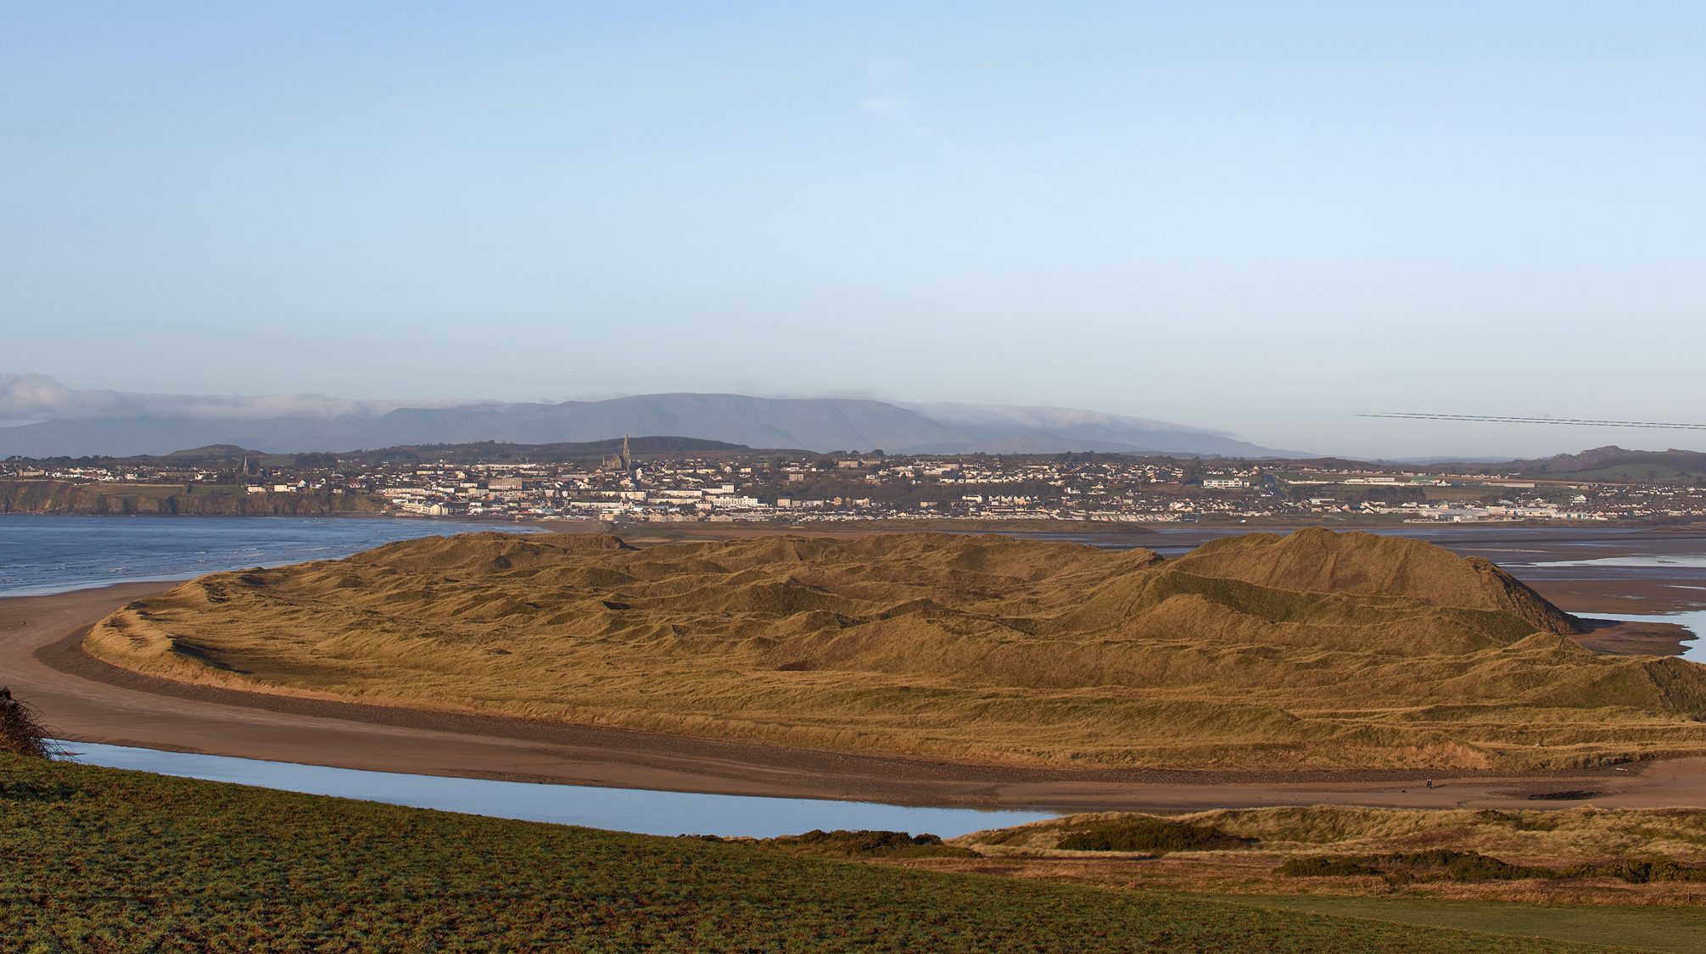
CUPLÁ
TRÁ
| TWIN BEACH

Slide 4
CUPLÁ
TRÁ
| TRÁ MHÓR
| TRAMORE

Slide 5
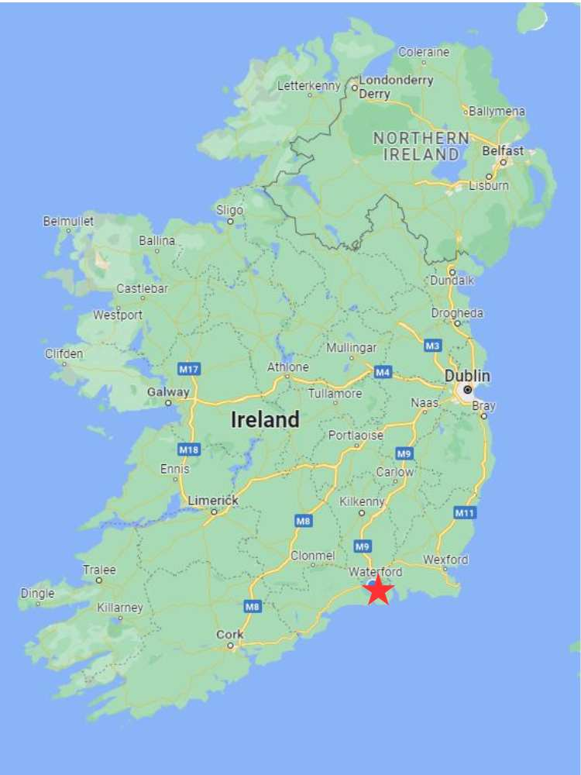
| TRAMORE
TRÁ
CUPLÁ

Slide 6
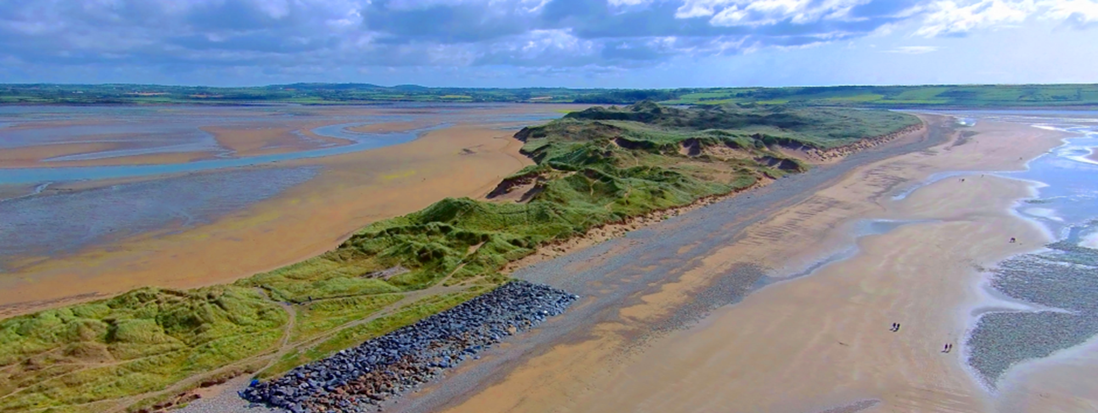
CUPLÁ
TRÁ
| TRAMORE
770 hectares
Special Area of Conservation
Special Protection Area
Ramsar Site
15 protected species and 9 habitats

Slide 7
CUPLÁ
TRÁ
| PROJECT ETHOS
Combining Digital Twin Technology with a Landscape Biography methodological framework to establish, better understand and communicate the competing influences, priorities and impact on the region from human and more-than-human activity to allow for improved regional planning and infrastructure initiatives.
Notes:
The overall aim of the project is find a sustainable way of balancing the protection of this natural environment, with the increased footfall from a growing town, increased tourism, effects of climate change and extreme weather event. And create predictive scenarios to show eg if the area was continued to be used as it is now, what would happen.
This is the first time these two concepts have been brought together and essentially we’re hoping to build a model and a methodology that can be replicated in other regions like this, to allow for their sustainable development.

Slide 8
CÚPLA
TRÁ
| LANDSCAPE BIOGRAPHY
Narrative of the dynamic relationship between human, non-human and environment
Emphasis on authors and authorship and landscape transformations of a layered landscape
Time-depth: long term perspective on a dynamic landscape – past, present and future
Collaborative and integrated thinking tool being used in the Netherlands – transcends disciplines
New eco-centric model and direction
Notes:
Cf than a Landscape Character Assessment
New direction to identify the non-human authors or agents that constitute a landscape.

Slide 9
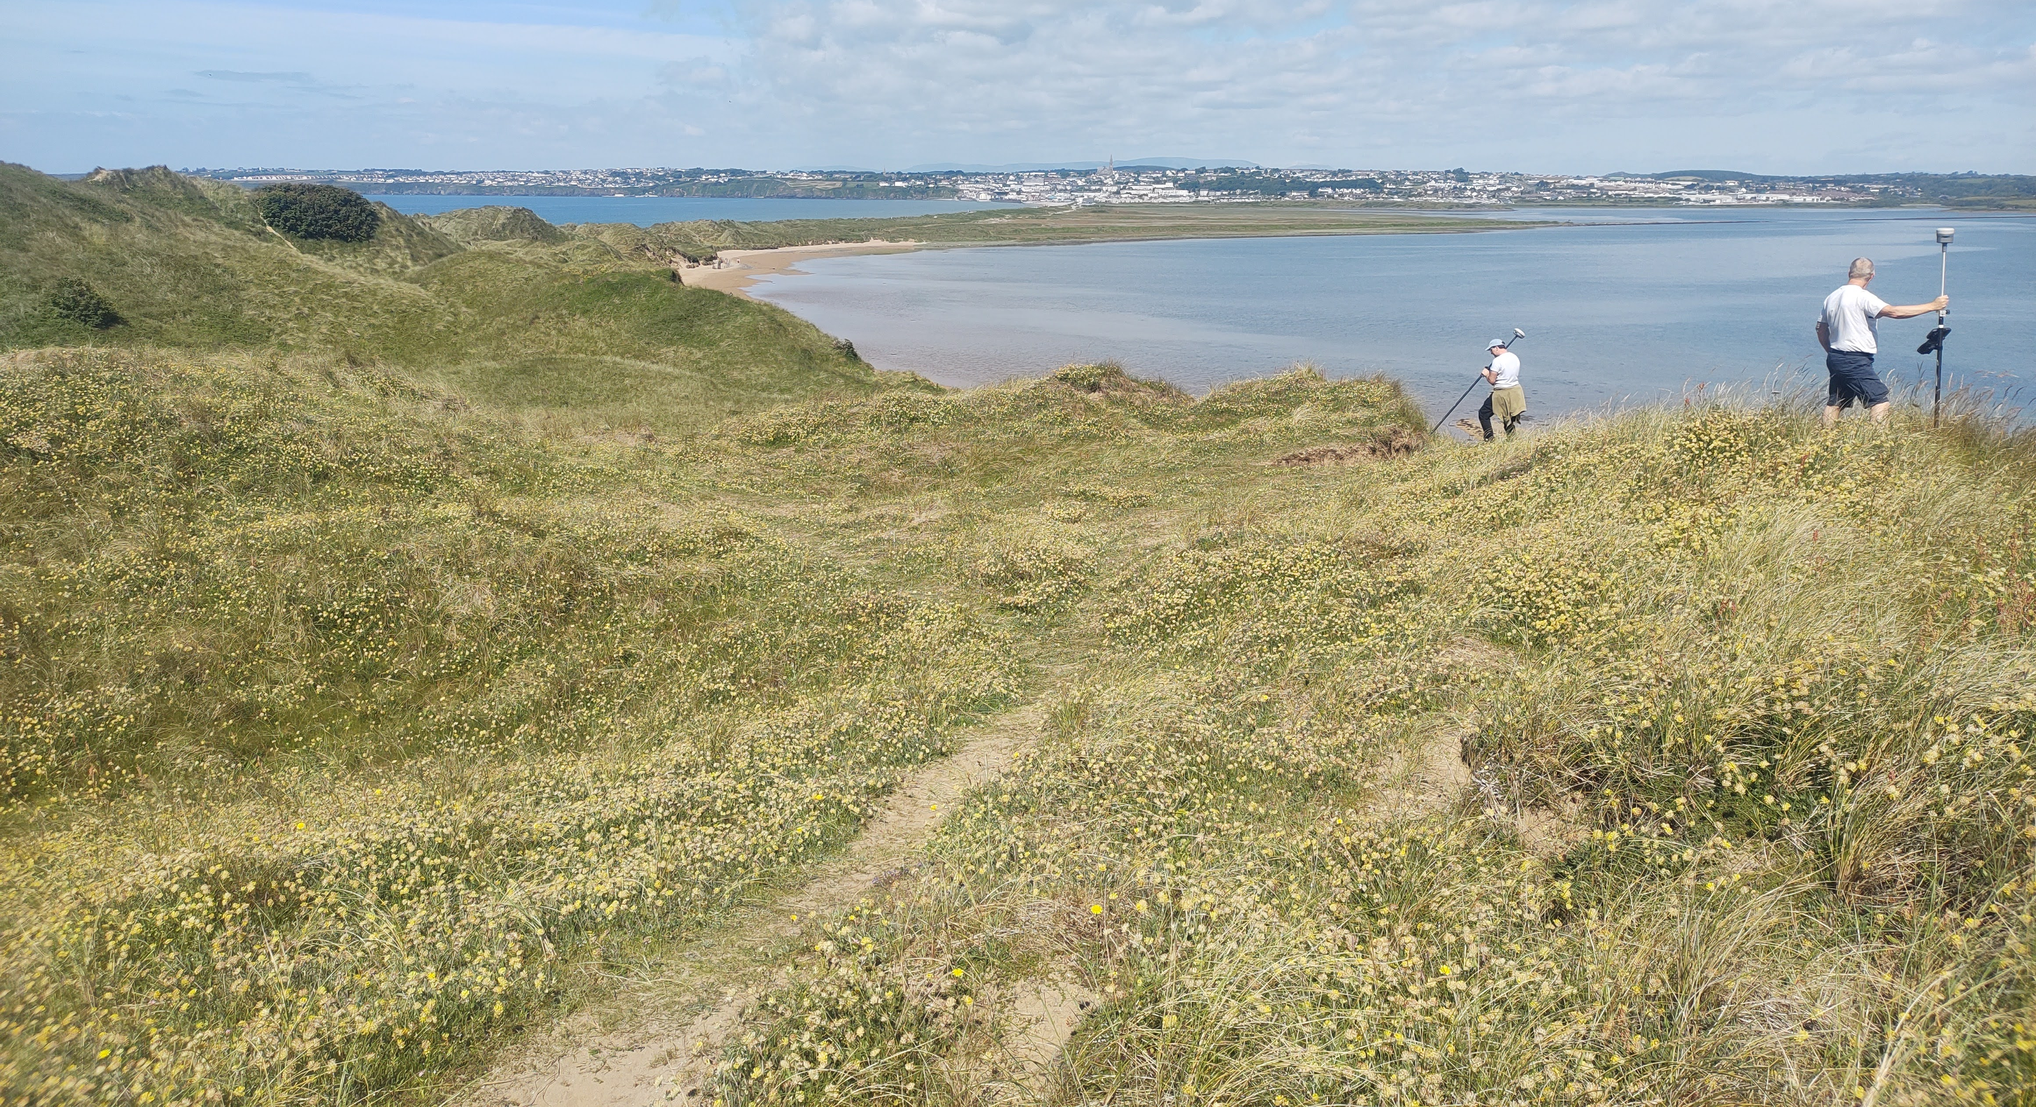
CÚPLA
TRÁ
| DIGITAL TWIN OF A NATURAL ENVIRONMENT
PUSHING BOUNDARIES
Developing Digital Twin capabilities – not just urban and built environment
Landscape Representation – spatial and temporal
Landscape Information Modelling
PRACTICAL CHALLENGES
Accuracy of representing a dynamic landscape
How to “twin reality” (Paul Cureton)
Notes:
(beyond simply integration of BIM and GIS)
Need to examine the terminology around this. Can it ever be a pure twin?

Slide 10
CÚPLA
TRÁ
| DIGITAL TWIN OF A NATURAL ENVIRONMENT
FIRST STEPS
Identify and appraise, incorporate all datasets, past and present
Creating new datasets
a current 3D model of the landscape
Lidar, drone footage, time lapse video
Unreal Engine, 3DS maps
Notes:
(beyond simply integration of BIM and GIS)
Need to examine the terminology around this. Can it ever be a pure twin?

Slide 11
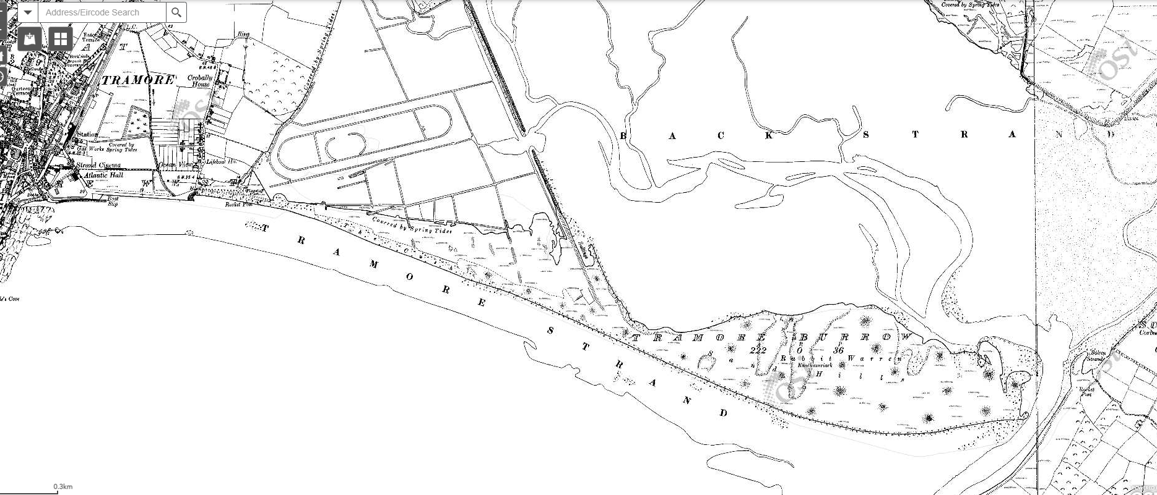
Notes:
GIS as base reference, Unity to “animate” and fill in gaps which historic and current datasets don’t cover
Past, present and future.

Slide 12
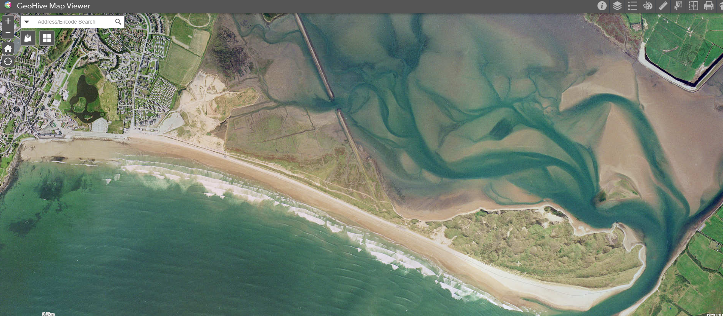
Cúpla
Trá
| Practicalities – First Steps
Notes:
GIS as base reference, Unity to “animate” and fill in gaps which historic and current datasets don’t cover
Past, present and future.

Slide 13
CÚPLA
TRÁ
| DIGITAL TWIN OF A NATURAL ENVIRONMENT
FIRST STEPS
Identify and appraise, incorporate all datasets, past and present
Creating new datasets
a current 3D model of the landscape
Lidar, drone footage, time lapse video
Unreal Engine, 3DS maps
Notes:
(beyond simply integration of BIM and GIS)
Need to examine the terminology around this. Can it ever be a pure twin?

Slide 14
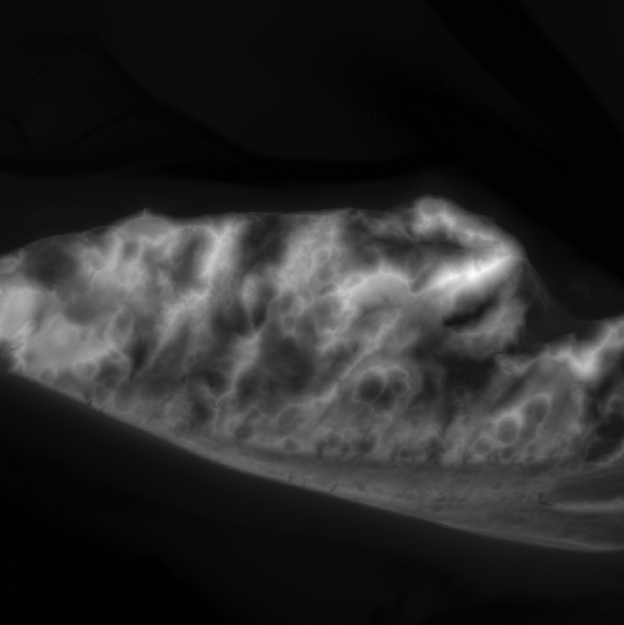
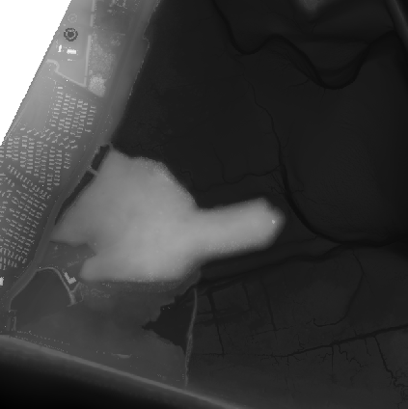
| FIRST STEPS
TRÁ
CÚPLA
Notes:
GIS as base reference, Unity to “animate” and fill in gaps which historic and current datasets don’t cover
Past, present and future.

Slide 17
PARADIGM SHIFTING |
POST PHENOMENOLOGY
Notes:
We want to create an experience, a phenomenological way of experiencing the landscape, but this creates a post phenomogolocal way because it’s not entirely accurate or “real” or “true” it will be a fictional representation in some ways and isn’t a direct experience because our human presence scares off birds and non human activity – the use of technology takes into post phenomenology – Don Ihde – of the mediation of experience through technology
Also enhancing accessibility making landscapes and landscape biographies accessible to a wider audience and revealing hidden patterns and changes in the landscape that may be missed by traditional methods.

Slide 18
CUPLA TRA | REAL WORLD IMPACT
Predictive scenarios – looking to the future
Dissemination by mission room
Inform local and national decision makers for planning
Conservation of area
To be replicated in similar at-risk regions

Slide 19
Emily.Shakespeare@setu.ie
Robin.stubbs@setu.ie
www.sabre-centre.ie

